Slide 1



SPOTIFY ANALYSIS PROJECT
Exploring Music Trends and Streaming Insights
By Shivam Gupta
LinkedIn

Slide 2

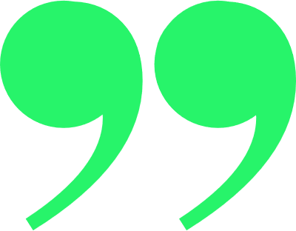




QUOTES
Rhythm and harmony find their way into the inward places of the soul.
-- Plato

Slide 3



OUR
Agenda
Introduction
Understanding the Dataset
Exploratory Data Analysis (EDA)
Hypothesis & Observations
Recommendations
Conclusion
Q&A / Thank You

Slide 4

Introduction
The music streaming industry has grown exponentially, with Spotify as a key player. This project analyzes Spotify dataset trends to uncover patterns in music popularity, song attributes, and user engagement.
Objectives
Identify factors influencing song popularity.
Explore trends in song attributes (tempo, danceability, energy, etc.).
Analyze the impact of genres, artists, and track duration on listener preferences.

Slide 5
Understanding the
Dataset
The dataset consists of multiple Spotify track attributes:
Track Name – Song title
Artist – Performing artist(s)
Album Name – Album where the song is featured
Popularity Score – Spotify-assigned score (0-100)
Danceability – How suitable a track is for dancing
Energy – Intensity and activity of the track
Loudness – Volume level in decibels
8. Speechiness – Presence of spoken words
9. Acousticness – Acoustic composition of the track
10. Instrumentalness – Presence of instrumental parts
11. Liveness – Probability that the track is a live recording
12. Valence – Emotional positivity of a song
13. Tempo – Speed of the track (BPM)
14. Genre – Music category

Slide 6
HYPOTHESIS
Let’s look at the hypothesis, we’ve created and will prove it

Slide 7

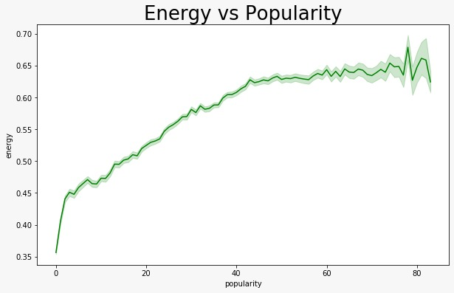
Hypothesis 1
Higher energy songs tend to be more popular.
Observation
Energy & popularity show a moderate positive correlation
Songs with high energy (above 80) generally score higher in popularity

Slide 8
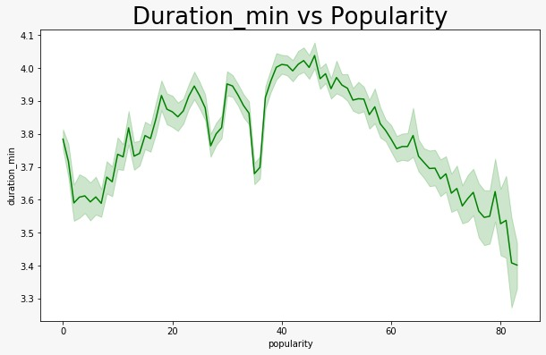
Hypothesis 2
Shorter songs (under 3 minutes) are more popular.
Observation
Trending songs tend to have shorter durations (~3 minutes or less).
Long tracks (>5 min) show lower popularity scores on average.

Slide 9
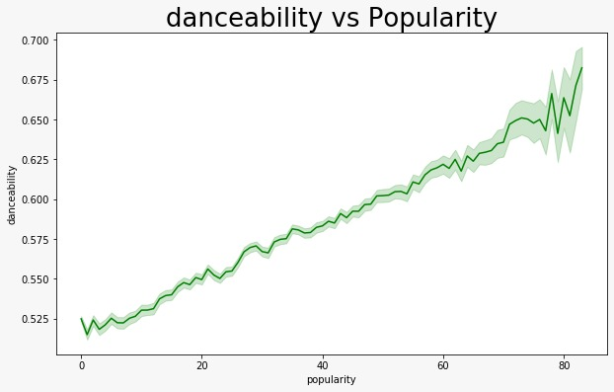
Hypothesis 3
Danceability is a key factor in song popularity.
Observation
Danceable tracks (score > 0.7) have higher listener engagement.
Genres like pop & electronic show higher danceability and popularity.

Slide 10
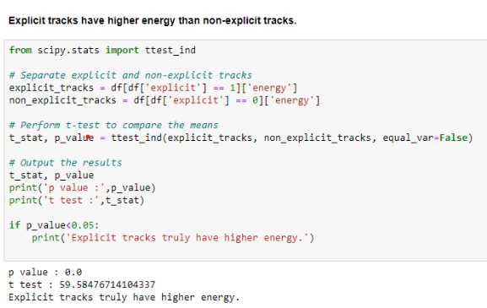
Hypothesis 4
Explicit tracks have higher energy than non-explicit tracks.
Observation
Energy & popularity show a moderate positive correlation
Songs with high energy (above 80) generally score higher in popularity

Slide 11
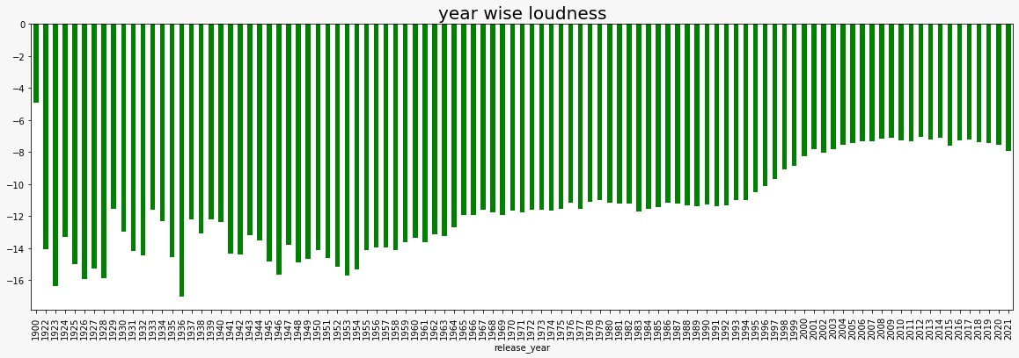
Hypothesis 5
Older songs tend to have lower loudness levels.
Observation
Songs released before the 2000s generally have lower loudness levels compared to modern tracks.
A negative correlation exists between release year and loudness, showing that older tracks are quieter on average

Slide 12



Recommendations
Music Producers & Artists
Focus on high-energy & danceable tracks for better engagement.
Keep songs under 3-4 minutes for higher streaming potential.
Spotify & Streaming Platforms
Use popularity trends to enhance song recommendations.
Optimize playlist curation based on listener preferences.
Marketers & Labels
Promote high-energy tracks for better playlist placements.
Leverage genre-based insights for targeted music promotions.

Slide 13

CONCLUSIONS
1
Energy, danceability, and tempo play a key role in determining a song’s popularity.
3
Pop & electronic genres are more likely to perform well on streaming platforms.
2
Shorter tracks (under 3 minutes) tend to gain higher engagement.
4
These insights help artists, music labels, and streaming services improve their strategies for promoting content.

Slide 14

CONTACT
INFORMATIONS
PHONE
+91 6388254660
EMAIL
shivamguptacpl@gmail.com
LINKEDIN
http://linkedin.com/in/shivamgupta-da
LOCATION
Lucknow

Slide 15


THANK'S FOR WATCHING

